Slide 1
Project Proposal: Flower_Recognition
Petar_Paskalev
232725

Slide 2
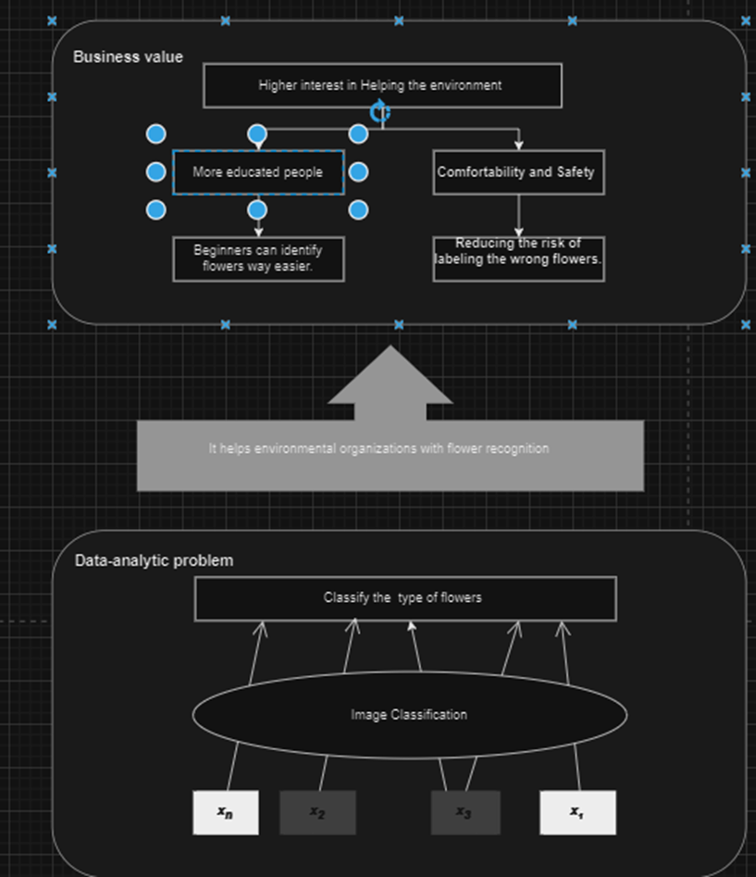
Project Pitch
Business Understanding
Create the first idea for your application:
Difficulty in identifying flower accurately.;
Conservationists need a reliable image classifier.;
DAPS Diagram: Illustrates my solution, an accurate flower species classifier;
My idea is to make an application that recognizes flowers.

Slide 3
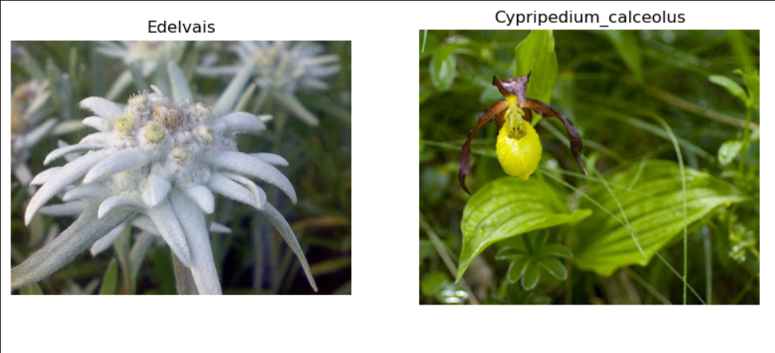
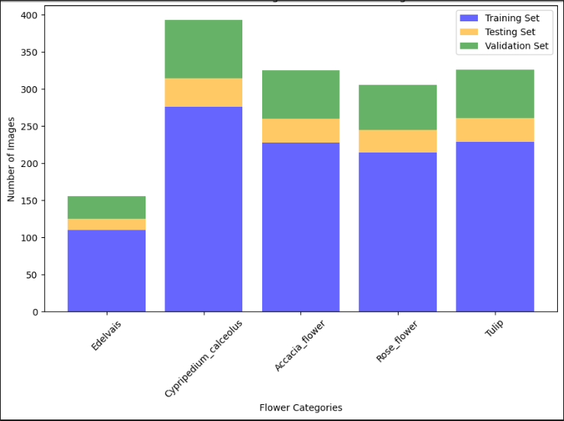

Problem Overview
Deep Learning
Explain your image classification problem:
My model calssifies flowers.
5 clasess
Show some examples of classes.
My images differ in every class
Human level performance accuracy - 66.07%
My random guess accuracy on the whole dataset is 26.09%
Basic Multilayer perceptron accuracy on validation is 67.81%

Slide 4
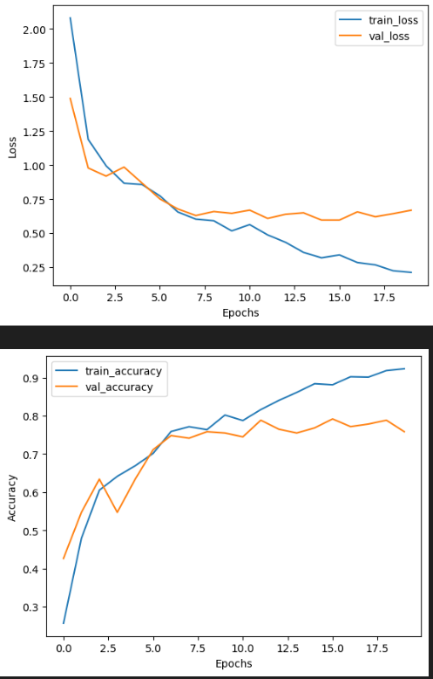
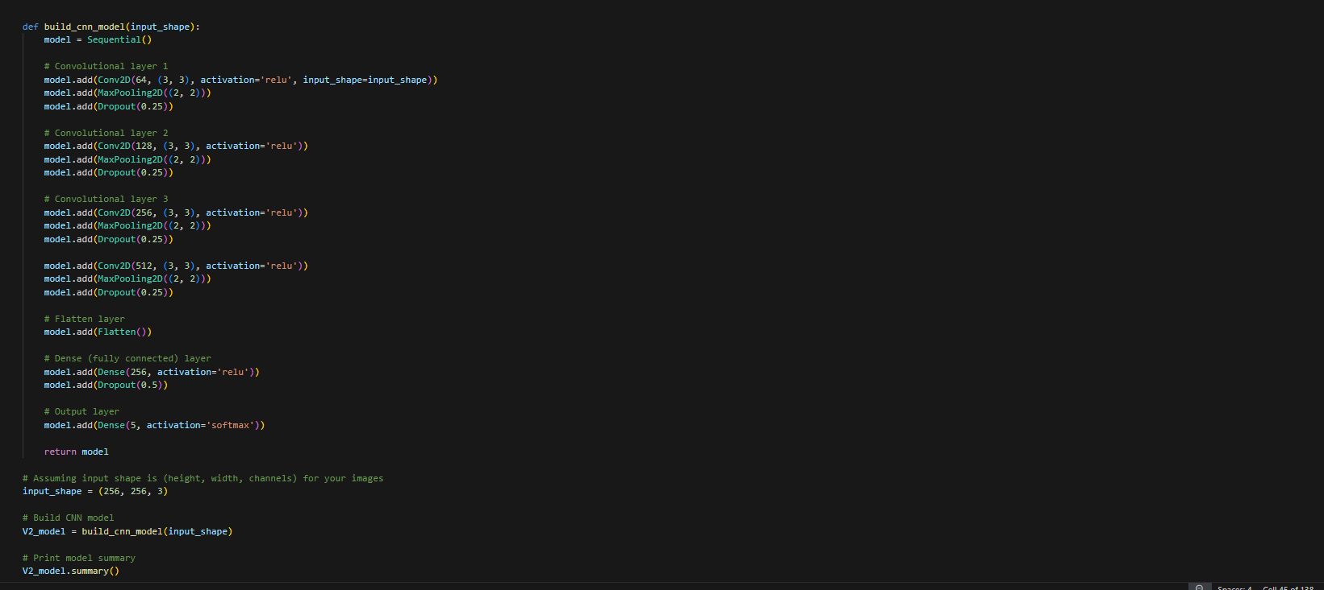
Model Overview
Deep Learning
The process:
Iteration 1 – normal cnn architecture 128 by 128 pixels
Iteration 2 – normal cnn architecture 256 by 256 pixels
Iteration 3 – Data augmentation
Notes:
In the beginning, a journey commenced with the creation of V1_model, a CNN tailored for image classification on 128x128 pixel images. Its architecture boasted three convolutional layers, augmented by max-pooling and dropout layers to curb overfitting. With the Adam optimizer and categorical crossentropy loss, its training commenced, achieving a commendable 78% accuracy.
Seeking greater heights, the second iteration unfolded, expanding to 256x256 pixel images with V2_model. Though its convolutional layers deepened, its performance waned slightly to 77% accuracy, a testament to the challenges of scale.
Undeterred, the third iteration introduced data augmentation, enriching the training dataset with horizontal flips. Despite the modest improvement to 79%, the quest for excellence persisted.
In the final chapter, transfer learning emerged as the key, summoning the venerable VGG16 model to augment V4_model. With its preternatural wisdom and the addition of custom dense layers, V4_model soared to new heights, achieving a remarkable 94% accuracy.
Thus, the journey concluded, each iteration a stepping stone toward mastery. From the humble beginnings of V1_model to the triumphant ascent of V4_model, the tale of evolution and perseverance echoed through the annals of machine learning history.

Slide 5
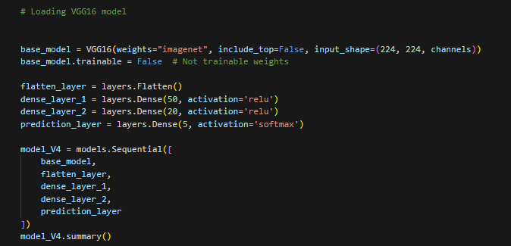
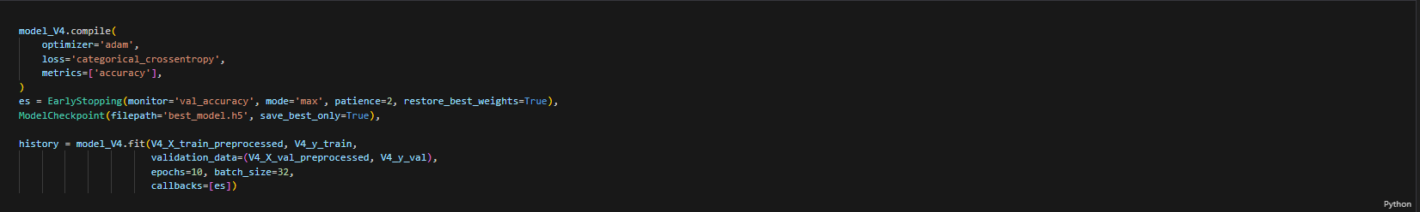
Model Overview
Deep Learning
Iteration 4 :
Vgg16 model was used for the best iteration.

Slide 6
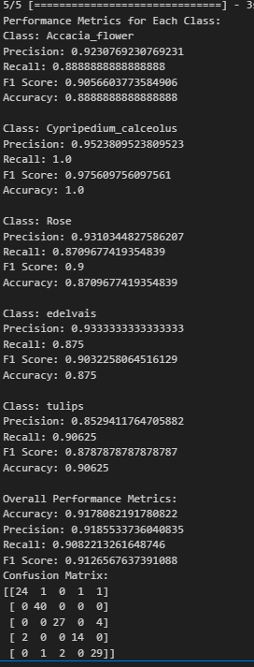
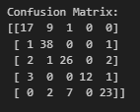
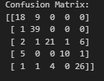
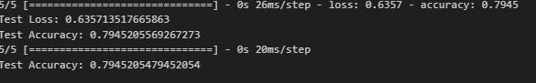

Model Performance
Deep Learning
Iteration 1:
Test accuracy of the model is 79 %
Iteration 2:
Test accuracy of 78 %
Iteration 3:
Test accuracy of 79 %
Iteration 4:
performance of the model is 94%

Slide 7
Model Interpretability
Responsible AI
Discuss the trade-off between accuracy and interpretability:
In the context of your application, which holds greater importance: achieving a high level of accuracy or ensuring interpretability?
What underlying pattern(s) does the model identify:
Which Explainable AI method(s) did you apply to the model?
Can you provide an example of how the model recognizes specific objects, textures, or shapes within the images, employing the abovementioned method?
Time Limit: 2 minutes

Slide 8
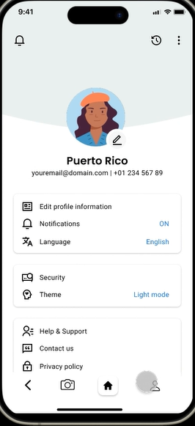
User Study
Human-Centered AI
Added more features (settings, in pay subscription)
Notes:
Briefly explain your study and the hypotheses you had:
Our study involved an A/B test to assess the efficacy of our plant identifier application. Hypotheses included expecting Version B to exhibit higher user satisfaction and usability compared to Version A, with specific focus on intuitiveness, usefulness, and overall enjoyment.
Clearly indicate how you incorporated the results in your final wireframe prototype:
We integrated statistical outcomes from the A/B test into our wireframe prototype by retaining elements from Version A that led to higher user satisfaction and usability. Additionally, areas for improvement identified through user feedback, such as button clarity, were addressed to enhance overall usability.
Reflect on the impact of the study results on your final design:
The study results guided our final design decisions, ensuring that user-centric features from both versions were incorporated. This approach helped optimize the wireframe prototype to meet user needs and preferences, enhancing the overall user experience of the plant identifier application.

Slide 9
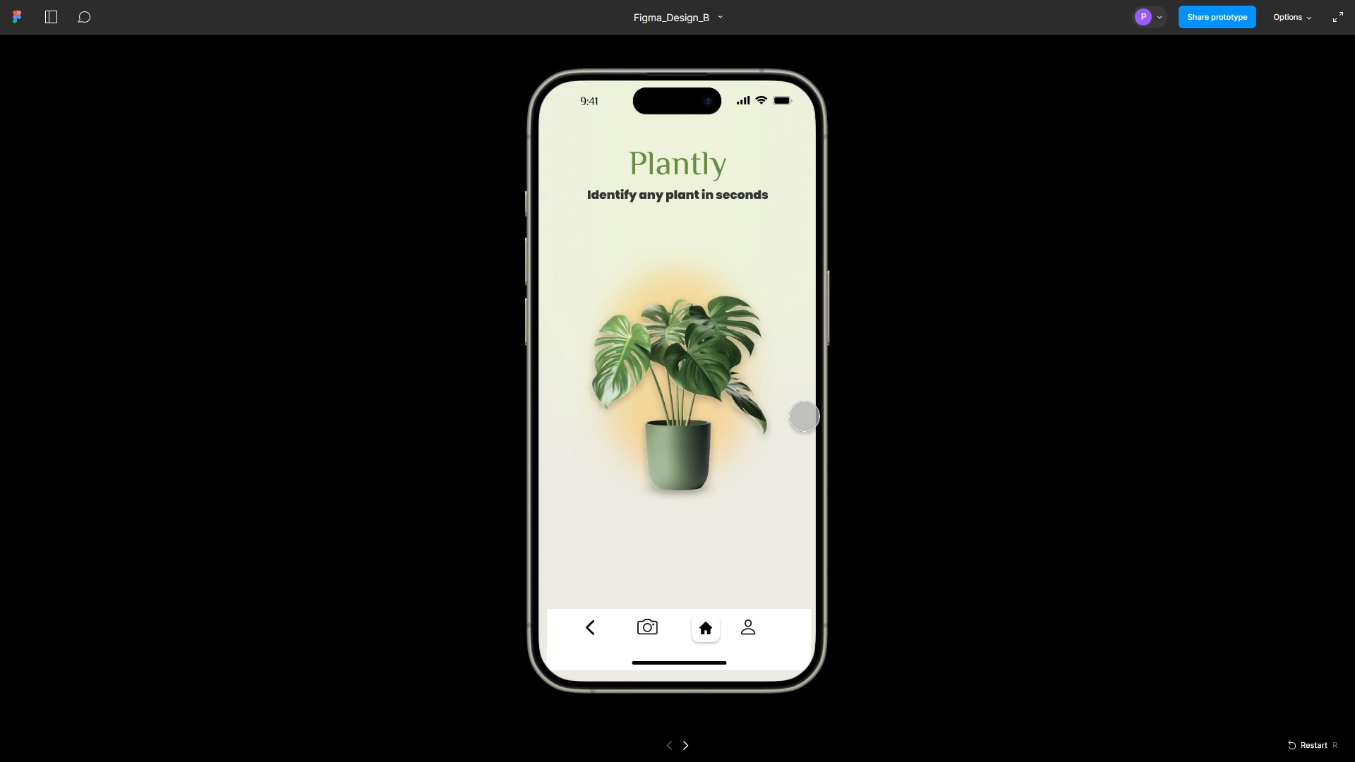
Demo
Human-Centered AI
Time Limit: 2 minute

Slide 10
Thank you!
Any questions?

